Slide 1

Data Communication and Computer Network BLM3051
Dr. Öğr. Üyesi Furkan ÇAKMAK

Slide 2

Lecture Information Form - Weekly Subjects
BLM3051
Data Communication and Computer Network - 5
Hafta | Tarih | Konular
1 | 20.02.2024 | Introduction to Data Communication Standards Used on Data Communication, Architectural models
2 | 27.02.2024 | OSI Reference Model , Layers and Their Functions, Signaling and Signal Encoding
3 | 05.03.2024 | Parallel and Serial Transmission, Communication Media and Their Technical Specs., Multiplexing (TDM, FDM)
4 | 12.03.2024 | Error Detection and Error Correction Techniques, Data Link Control Techniques, Flow Control
5 | 19.03.2024 | Asynchronous and Synchronous Data Link Protocols (BSC, HDLC)
6 | 26.03.2024 | LAN Technologies Continued, IEEE 802.4, 802.5, 802.11
7 | 02.04.2024 | Connectionless and Connection Oriented Services, Switching
8 | 09.04.2024 | Tatil – Ramazan Bayramı Arifesi
9 | 16.04.2024 | 1. Ara Sınav
10 | 23.04.2024 | Tatil – 23 Nisan Ulusal Egemenlik ve Çocuk Bayramı
11 | 30.04.2024 | Static and Dynamic Routing, Congestion in the Network Layer, Its Causes and Solutions
12 | 07.05.2024 | IP (Internetworking Protocol), ICMP, BOOTP, DHCP
13 | 14.05.2024 | 2. Ara Sınav
14 | 21.05.2024 | UDP (User Datagram Protocol), TCP (Transmisson Control Protocol)
Dr. Öğr. Üyesi Furkan ÇAKMAK

Slide 3
Data Link Control
BLM3051
Data Communication and Computer Network - 5
Basic tasks of the data link layer:
Framming and determining of start and end points to ensure synchronization
Flow control
Error control / Retransmission
Addressing
Line dicipline / Link management
Dr. Öğr. Üyesi Furkan ÇAKMAK

Slide 4
Line Dicipline / Link Management
BLM3051
Data Communication and Computer Network - 5
Enq/Ack (Enquiry/Acknowledgement)
Poll/Select Connection Management
Dr. Öğr. Üyesi Furkan ÇAKMAK

Slide 5
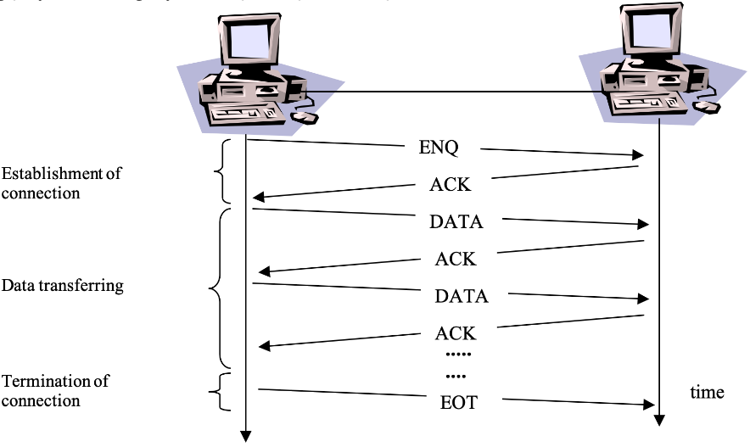
Enq/Ack (Enquiry/Acknowledgement)
BLM3051
Data Communication and Computer Network - 5
Point to point (in WANs)
Units are expected to have equal properties
Dr. Öğr. Üyesi Furkan ÇAKMAK

Slide 6
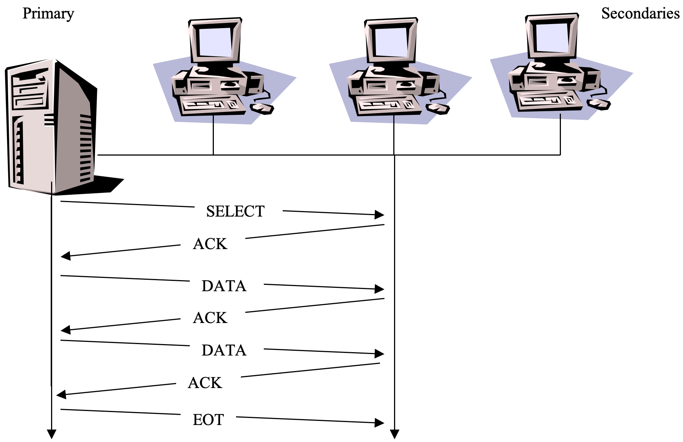
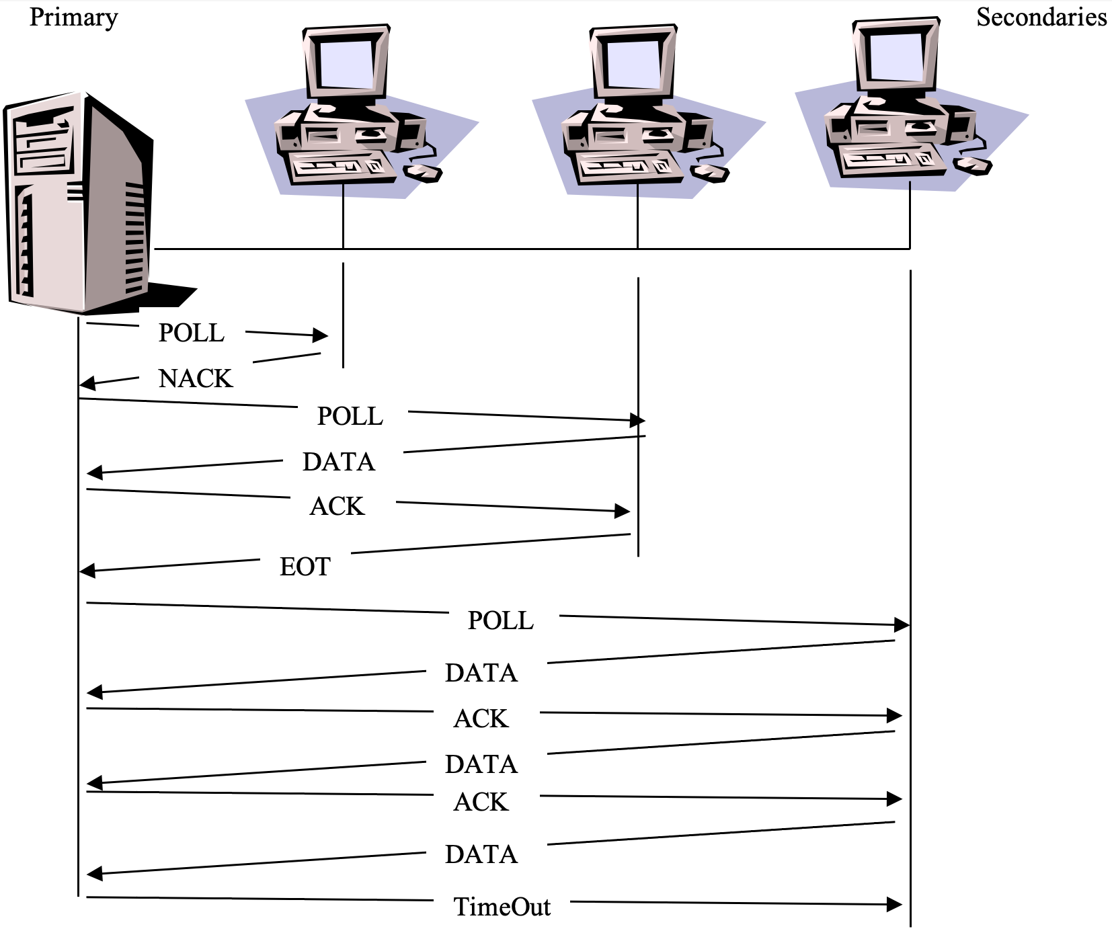
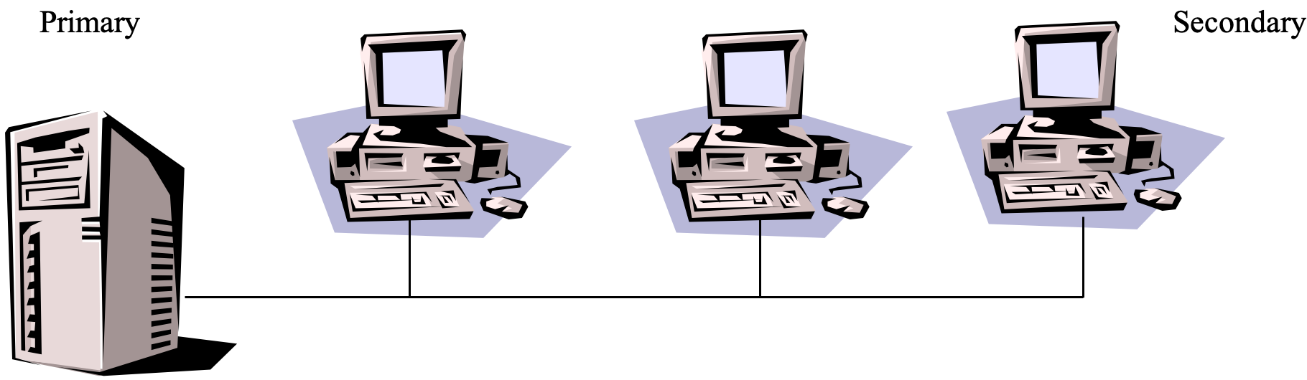
Poll/Select Connection Management
BLM3051
Data Communication and Computer Network - 5
Multi-point (in LANs)
Dr. Öğr. Üyesi Furkan ÇAKMAK

Slide 7
Flow Control
BLM3051
Data Communication and Computer Network - 5
Overwhelm
Buffer
There are two basic techniques:
Stop & Wait
Sliding Window
Dr. Öğr. Üyesi Furkan ÇAKMAK

Slide 8
Stop & Wait
BLM3051
Data Communication and Computer Network - 5
ACK is required for every transfer.
Pros:
Packages consist of smaller pieces
Effective use of buffers
Medium is busy for a shorter time
Error probability decreases
Error control processing times are shortened.
Wait time may be shorter for other devices in LANs.
Dr. Öğr. Üyesi Furkan ÇAKMAK

Slide 9

Stop & Wait – Line Utilization (U) Rate
BLM3051
Data Communication and Computer Network - 5
t_{frame}: Transmission time of a single frame
t_{prop}: The time it takes from the sender to the receiver
t_{ack}: The time it takes for all bits of the ACK to exit the receiver
T_{F} = t_{frame}+ t_{prop}+ t_{ack}+ t_{prop}
T_{F} = t_{frame}+ 2t_{prop}
$U=\frac{t_{frame}}{t_{frame}+2t_{prop}}$
$a=\frac{t_{prop}}{t_{frame}}⟹U=\frac{1}{1+2a}$
$t_{prop}=\frac{distance}{velocity}=\frac{d}{v} and t_{frame}=\frac{frameSize}{dataRate}=\frac{L}{R}$
Dr. Öğr. Üyesi Furkan ÇAKMAK

Slide 10


Stop & Wait – Line Utilization (U) Rate – Con’t
BLM3051
Data Communication and Computer Network - 5
Example:
Data communication is made between two points at a distance of 1000 km (d = 1000 km = 10⁶ m) at a speed of 155.52 Mbps (R=155.52 10⁶ bit/sec).
The transmission speed of the line is 200.000.000 m/sec (V=2 10⁸ m/sec).
Frame size is 424 bits (L = 424 bit).
What is the Line Utilization (U) in Stop & Wait Flow Control mode?
Answer
$a=\frac{t_{prop}}{t_{frame}}⟹U=\frac{1}{1+2a}$
$t_{prop}=\frac{distance}{velocity}=\frac{d}{v} and t_{frame}=\frac{frameSize}{dataRate}=\frac{L}{R}$
$\frac{\frac{{10}^{6}}{155,52x{10}^{6}}}{\frac{424}{2x{10}^{8}}}≈3030$
$\frac{1}{1+2x3030} ≈1,65x{10}^{−4}$
Dr. Öğr. Üyesi Furkan ÇAKMAK

Slide 11

Sliding Window
BLM3051
Data Communication and Computer Network - 5
U rate is low in Stop & Wait
The sender sends a certain amount of data to the receiver without ACK data.
Frames are transmitted in convoys.
The receiver can send ACK data for several frames.
Frame number is necessary
n-bit $⇒ 2^{n}$ frame
Piggy backing
Dr. Öğr. Üyesi Furkan ÇAKMAK

Slide 12
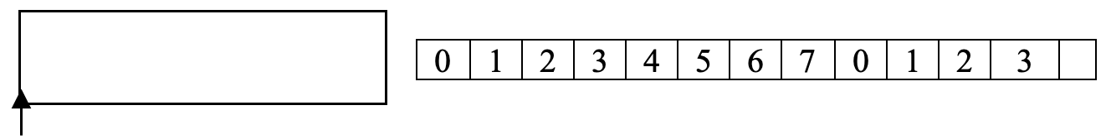
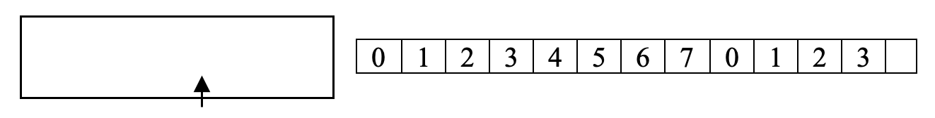

Sliding Window – Sender Side
BLM3051
Data Communication and Computer Network - 5
Window size: 2^{n}-1
Example: If frame sequence number bit length is n=3, windows size is 2^{n}-1 = 7
Dr. Öğr. Üyesi Furkan ÇAKMAK

Slide 13
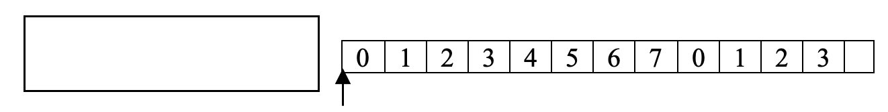
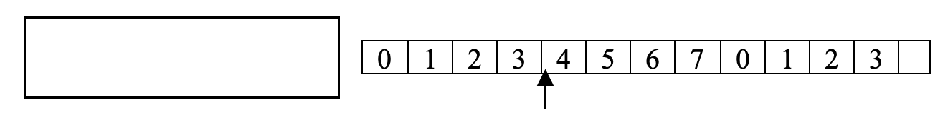

Sliding Window – Receiver Side
BLM3051
Data Communication and Computer Network - 5
Dr. Öğr. Üyesi Furkan ÇAKMAK

Slide 14
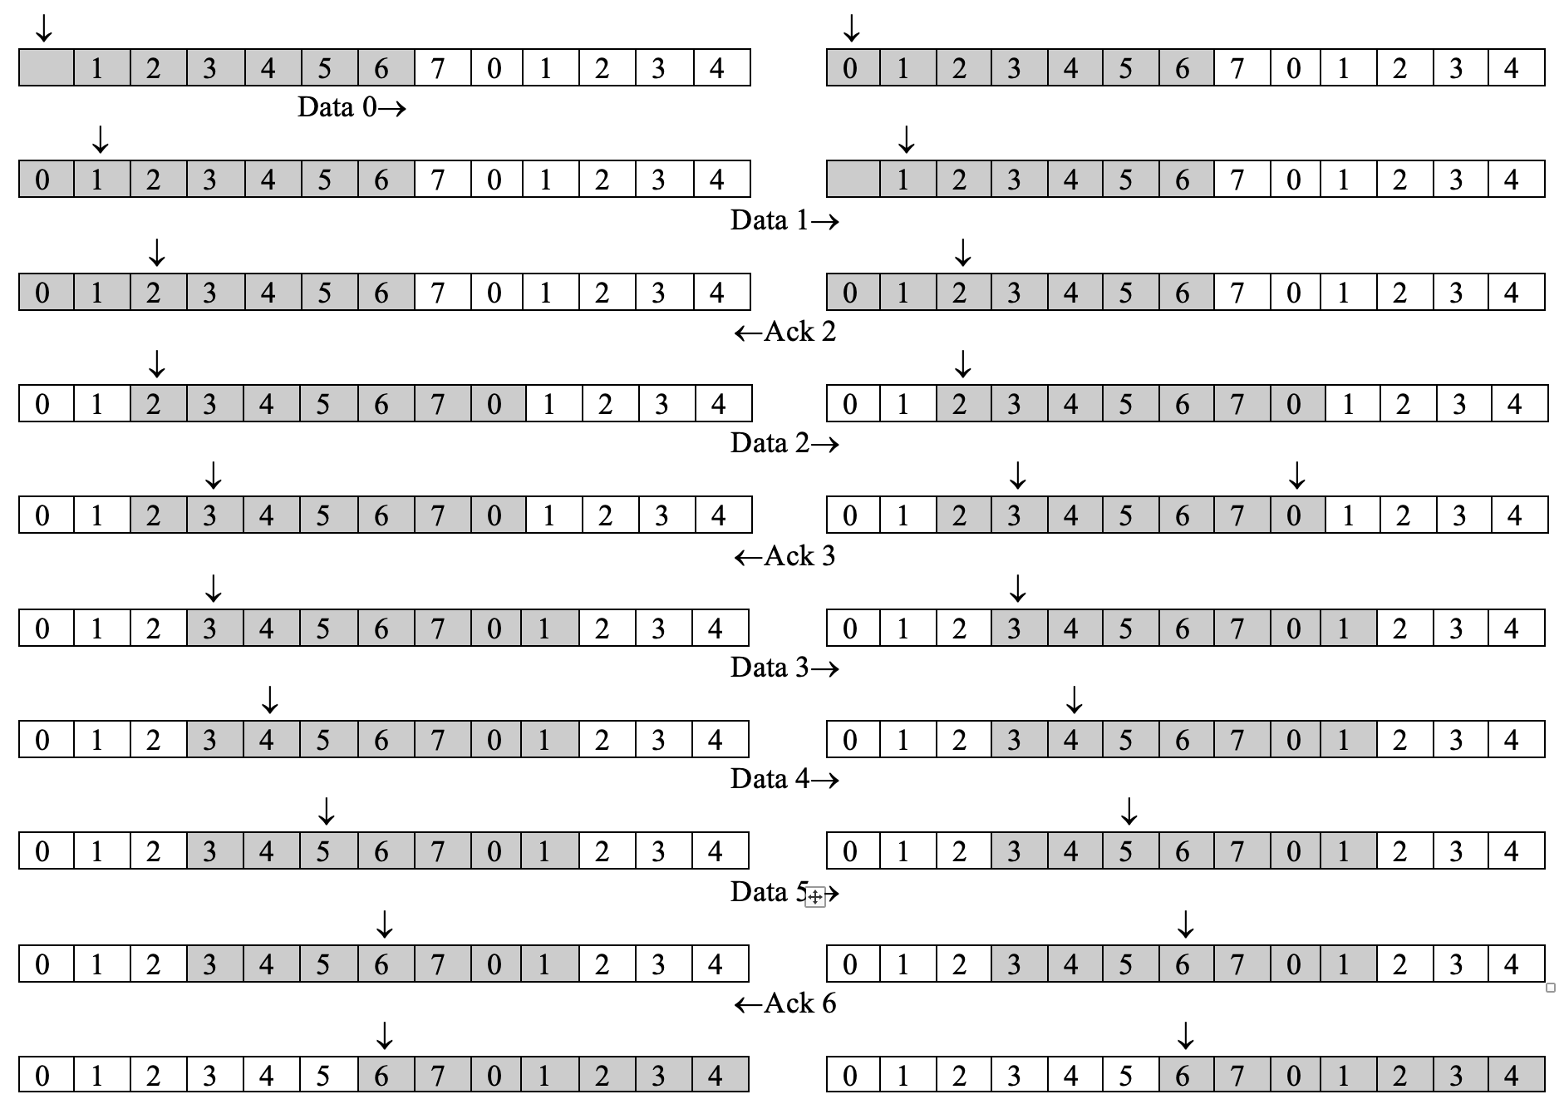
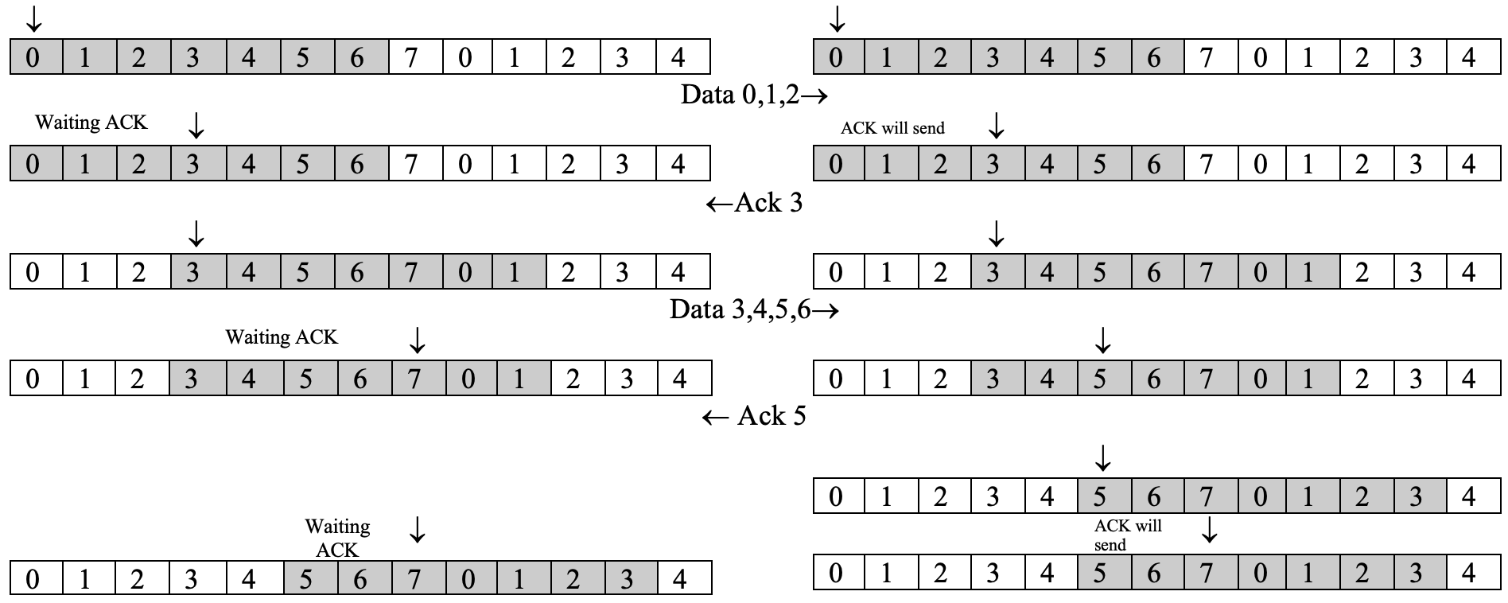
Sliding Window – Both Side Example
BLM3051
Data Communication and Computer Network - 5
Dr. Öğr. Üyesi Furkan ÇAKMAK

Slide 15
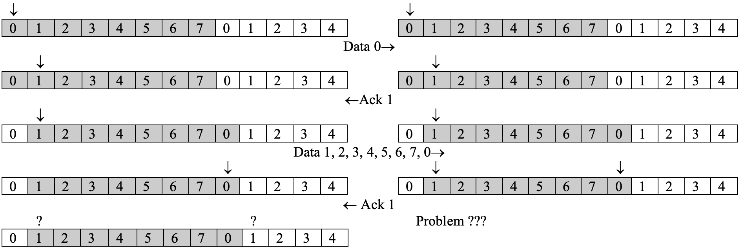
Sliding Window – Window Size 2^{n}-1
BLM3051
Data Communication and Computer Network - 5
Dr. Öğr. Üyesi Furkan ÇAKMAK

Slide 16

Sliding Window - Line Utilization (U) Rate
BLM3051
Data Communication and Computer Network - 5
In Stop & Wait $a=\frac{t_{prop}}{t_{frame}}$
In Sliding Windows $t_{frame}=1 ⟹a= t_{prop}$
If w (window size) ≥ (2a +1)
U = %100
If w < (2a+1)
$U= \frac{w}{2a+1}$
$U=\left\{\begin{matrix}1 & w≥2a+1 \\ \frac{w}{2a+1} & w<2a+1\end{matrix}\right\}$
Dr. Öğr. Üyesi Furkan ÇAKMAK

Slide 17
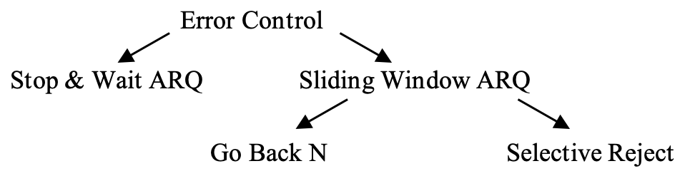
Error Control, Automatic Repeat reQuest (ARQ)
BLM3051
Data Communication and Computer Network - 5
Dr. Öğr. Üyesi Furkan ÇAKMAK

Slide 18
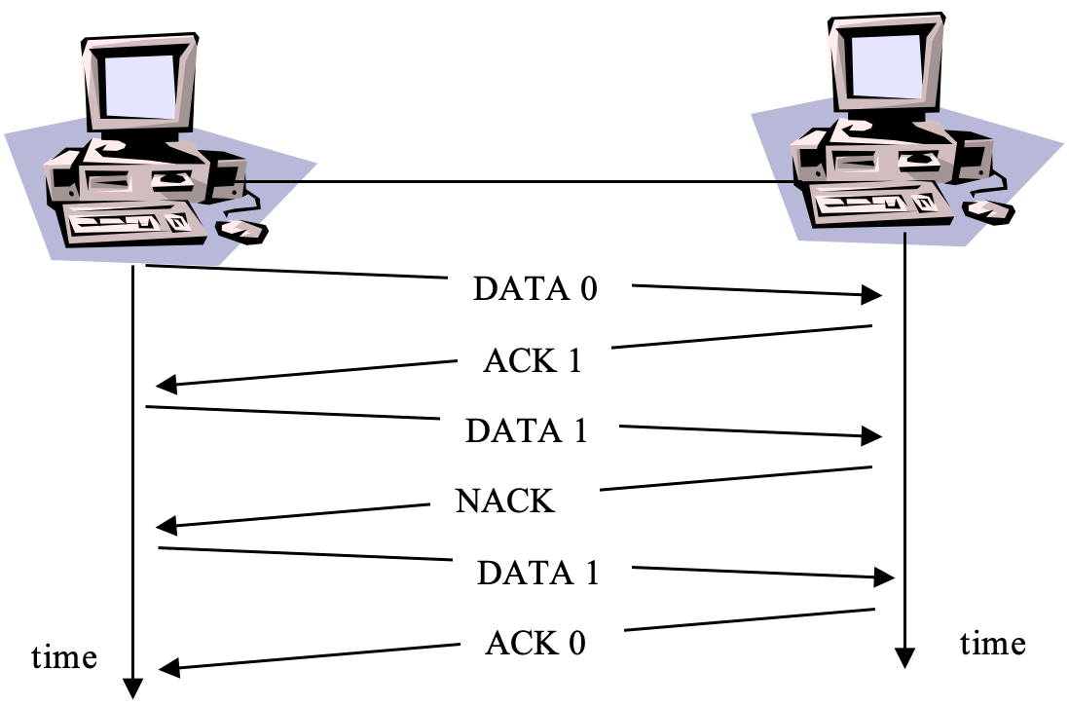
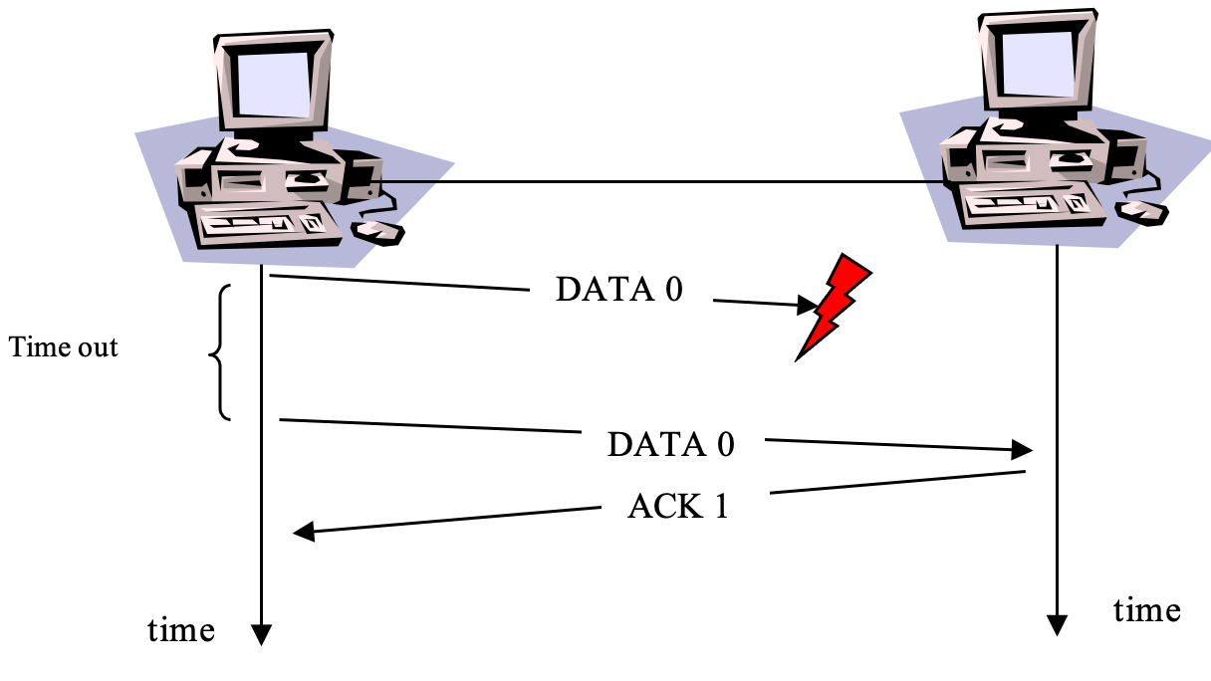
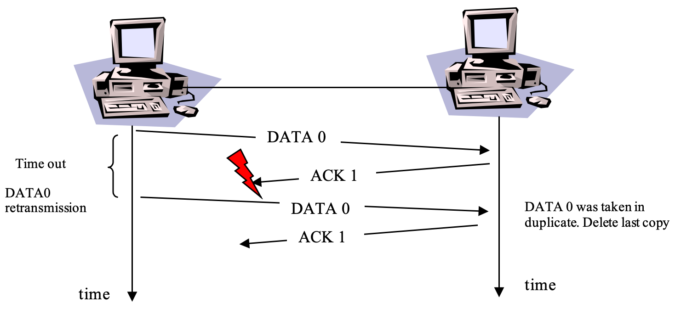
Stop & Wait ARQ
BLM3051
Data Communication and Computer Network - 5
Dr. Öğr. Üyesi Furkan ÇAKMAK

Slide 19
Sliding Window ARQ
BLM3051
Data Communication and Computer Network - 5
There are some differences caused by the sliding window technique when the frames inside the window are sent without a receipt.
The sender continues to store the frames in the buffer until it receives ACK for the frames.
In the ACK / NACK information coming from the receiver, there will be a number field showing which numbered frame it is for.
Receive Ready
RR 3 and RR 6 means: I have received 3, 4, 5 numbered frames, waiting for frame 6.
Each faulty frame is immediately reported by the receiver to the sender.
REJ - Reject
SREJ – Selective Reject
The sender also has a timer in the sliding window approach.
Lost data frame
Lost acknowledge frame
Dr. Öğr. Üyesi Furkan ÇAKMAK

Slide 20
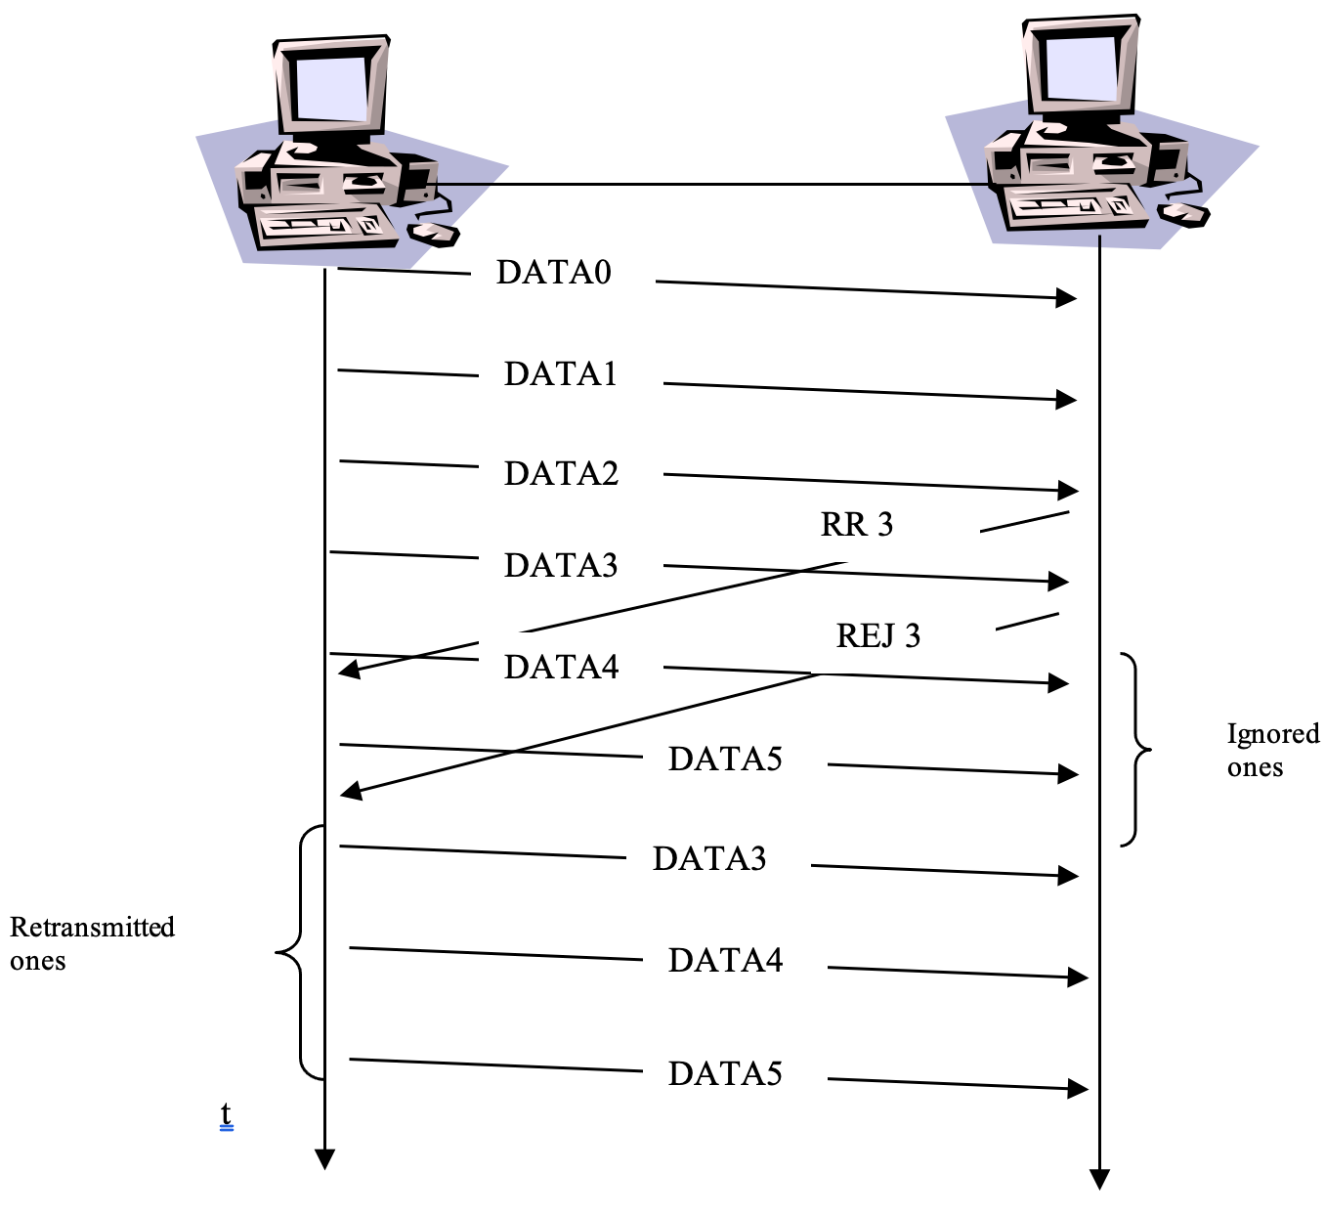
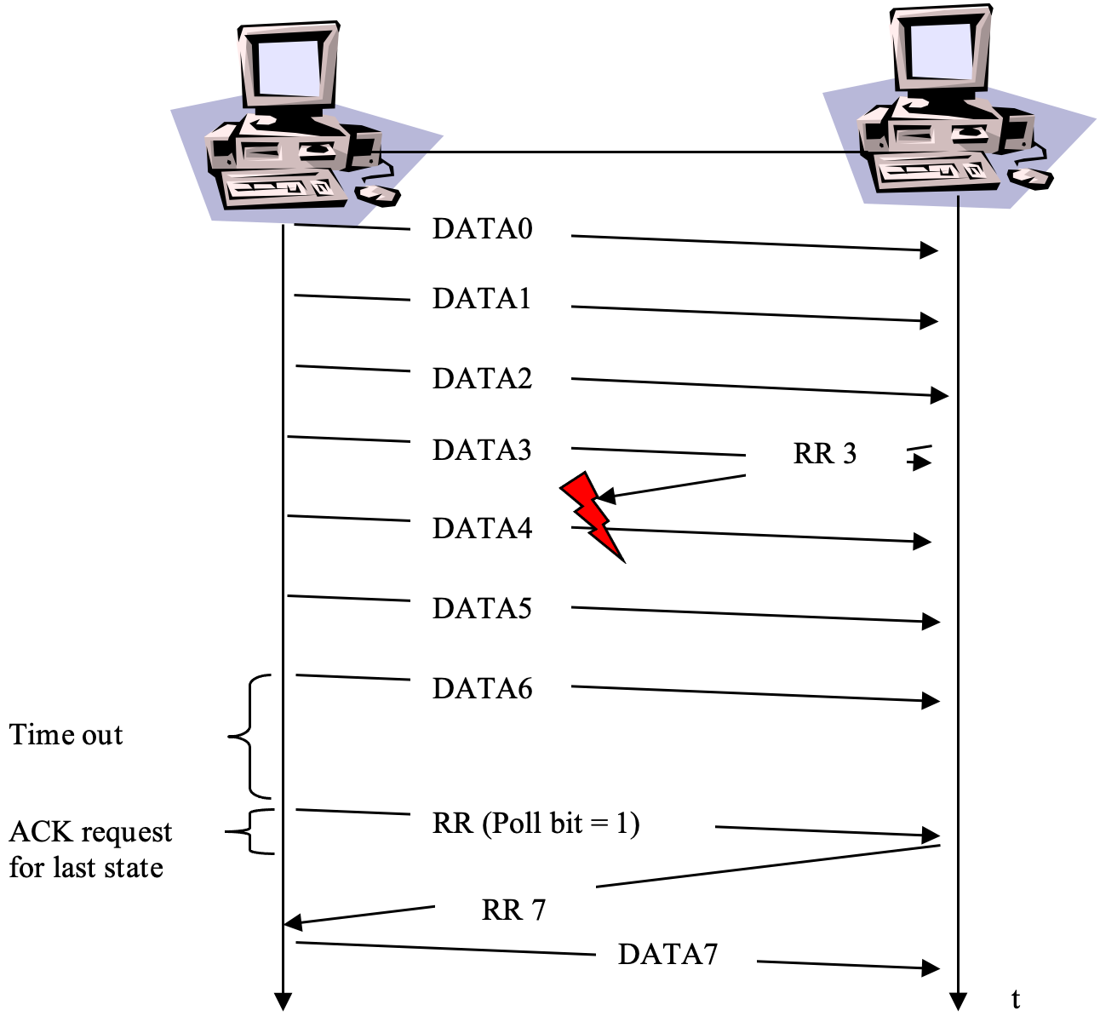
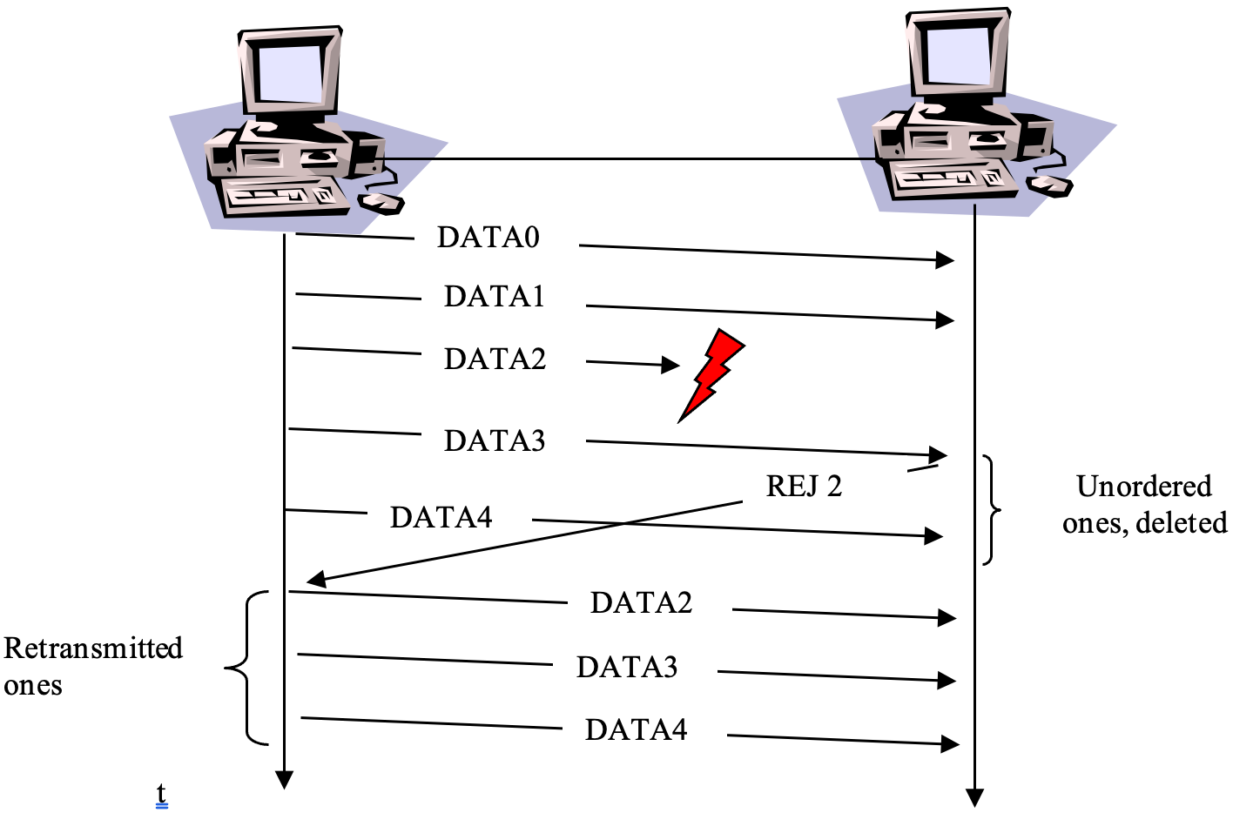
Sliding Window – Go Back n ARQ
BLM3051
Data Communication and Computer Network - 5
Dr. Öğr. Üyesi Furkan ÇAKMAK

Slide 21
Sliding Window - Selective Reject / Selective Repeat ARQ
BLM3051
Data Communication and Computer Network - 5
In this technique, the receiver will receive the frames unordered.
Search and Sort Algorithms are necessary.
Processing complexity increases
In Go Back n: w = (2^{n}–1)
In Selective Reject: w ≤ (2^{n}+1)/2
SREJ
The receiver accepts frames without error after faulty frame.
Frames will come in different order due to faulty frames.
Duplicated ones
Dr. Öğr. Üyesi Furkan ÇAKMAK

Slide 22
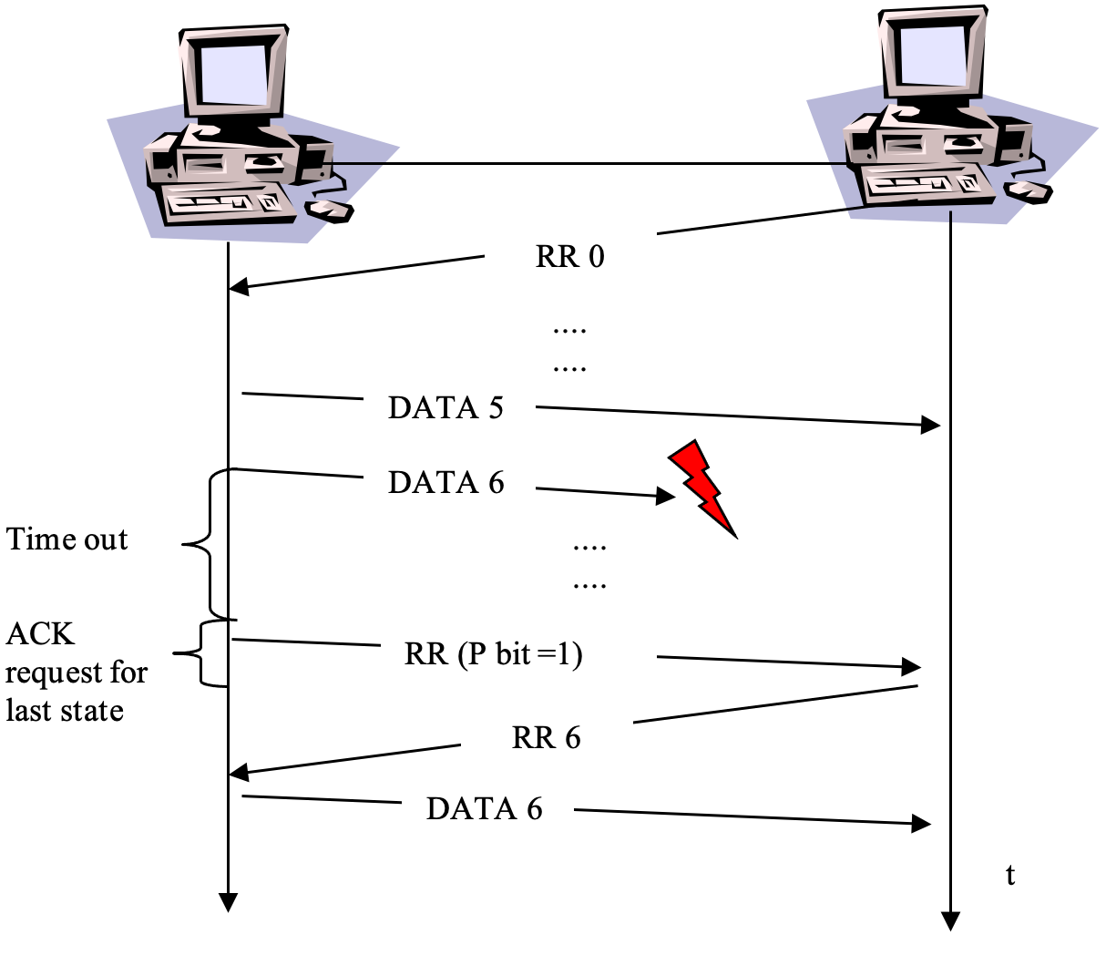
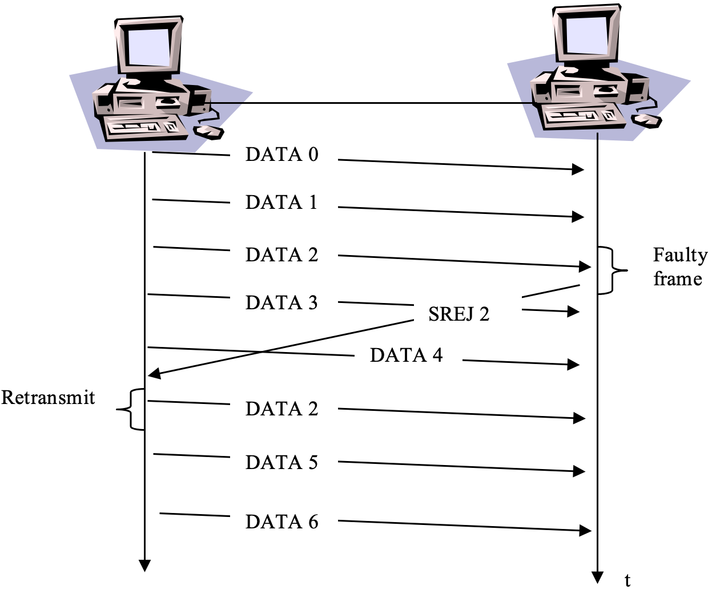
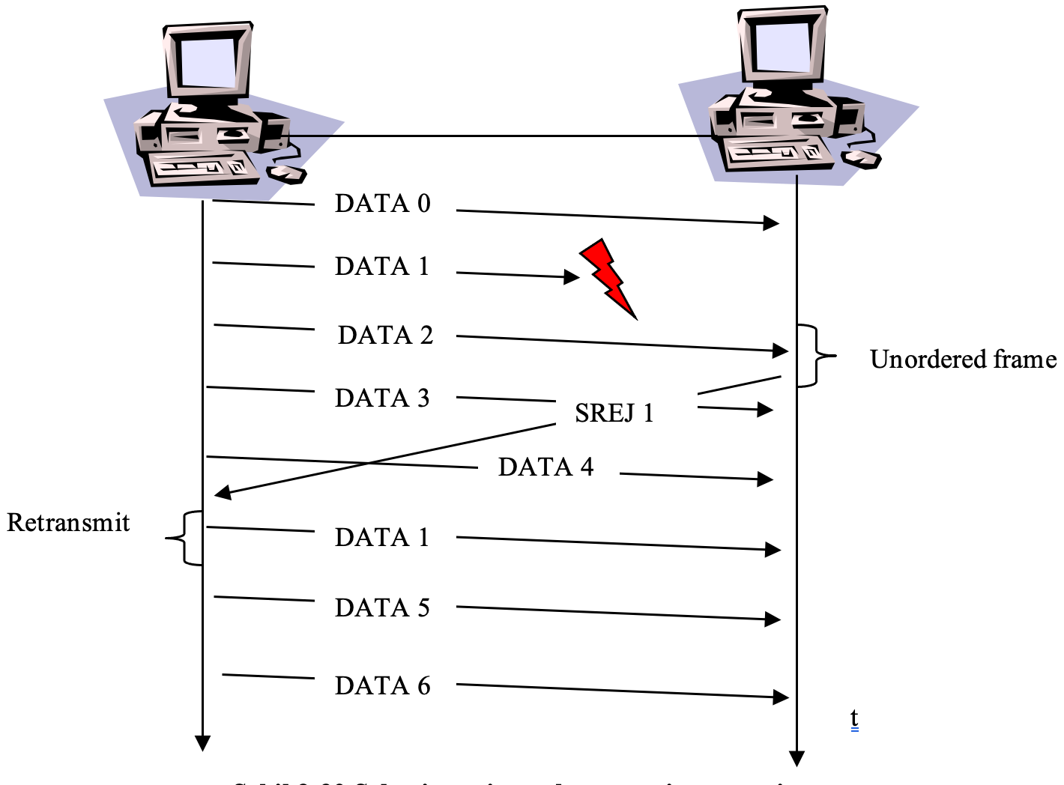
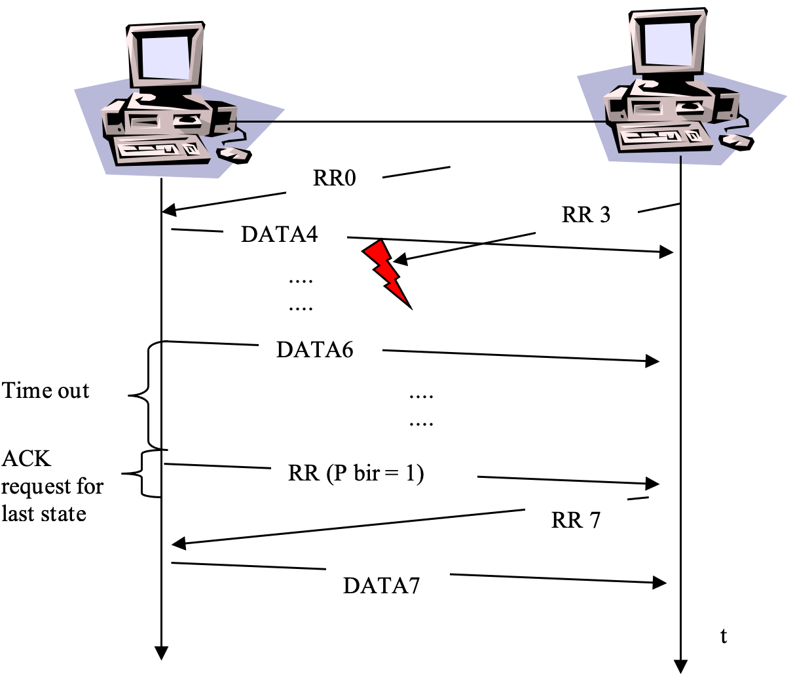
Sliding Window - Selective Reject / Selective Repeat ARQ - Con’t
BLM3051
Data Communication and Computer Network - 5
Dr. Öğr. Üyesi Furkan ÇAKMAK
Notes:
Screen Shot 2020-11-09 at 00.35.20

Slide 23
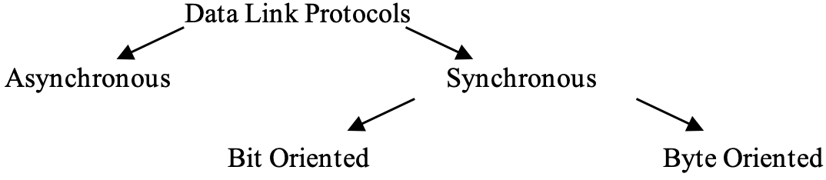
Data Link Protocols
BLM3051
Data Communication and Computer Network - 5
Protocol is a set of rules used to perform the necessary operations during data flow.
Synchronous
Asynchronous
Dr. Öğr. Üyesi Furkan ÇAKMAK

Slide 24
Data Link Controls (DTC)
BLM3051
Data Communication and Computer Network - 5
Components
Software
Hardware (UART/USART)
Tasks
Synchronous Transmission
Physical Level: Common timing signal
Logical Level: Special bit or bit-arrays
Flow Control
Error Control
Transmission Rules
Which one is sender/receiver?
Whether frames are for data or control purposes
Dr. Öğr. Üyesi Furkan ÇAKMAK

Slide 25
Asynchronous Protocols
BLM3051
Data Communication and Computer Network - 5
Used for connections made with a modem
Logical Sync.
Start bit
End bit
There may be gaps of variable sizes between data blocks.
Cons: Additional data
Cons: Slow transmission
Most Common Examples:
X-Modem
Y-Modem
Z-Modem
Kermit
Dr. Öğr. Üyesi Furkan ÇAKMAK

Slide 26
Synchronous Protocols
BLM3051
Data Communication and Computer Network - 5
Instead of start and end bits, FLAGS is used
Synchronization premise (SYN) bit-arrays
Synchronization successor (EOT) bit-arrays
2 types:
Physical Level Synchronization
Common Clock Signal
Logical Level Synchronization (in Data Link Layer)
FLAGs
Thanks to the fast transmission
Used in LAN, MAN and WAN technologies
The protocol perceives the data sent as a consecutive byte sequence.
According to the coding system used (ASCII or EBCDIC)
Dr. Öğr. Üyesi Furkan ÇAKMAK
Notes:
Synchronization premise: Eşzamanlılık öncülü
Synchronization successor: Eşzamanlılık ardılı

Slide 27
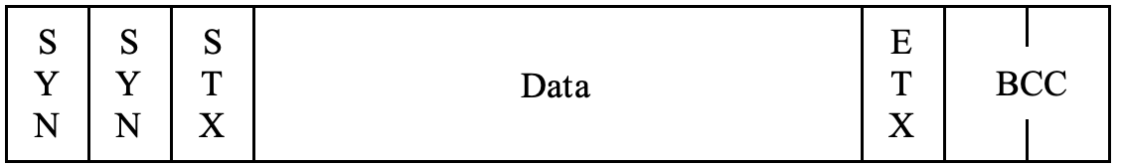
Synchronous Protocols – Byte Oriented
BLM3051
Data Communication and Computer Network - 5
Control Chars | Explanation
SYN | Synchronous idle (makes the channel active)
PAD | Frame PAD (used for completion)
DLE | Data Link Escape (Escape char for control chars)
ENQ | Enquiry (Request)
SOH | Start of Heading
STX | Start of Text
ITB | End of Intermediate Block
ETB | End of Transmission Block
ETX | End of Text
EOT | End of Transmission
BCC | Block Check Count (LRC -> 1 byte, CRC -> 2 bytes)
ACK0 | Acknowledge Even Numbered Blocks
ACK1 | Acknowledge Odd Numbered Blocks
WACK | Wait Before Transmitting
TTD | Temporary Text Delay (While filling buffer in sender side)
RVI | Reverse Interrupt (Request for urgent response)
NUL | (Filling spaces)
*Character Oriented
ASCII or EBCDIC coding
2 types of frames
Control frames
Data frames
Dr. Öğr. Üyesi Furkan ÇAKMAK

Slide 28
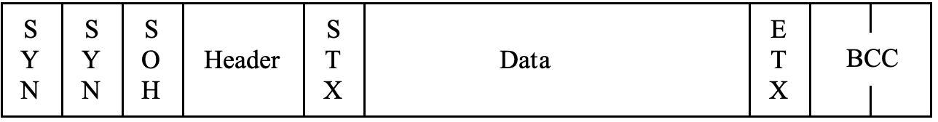
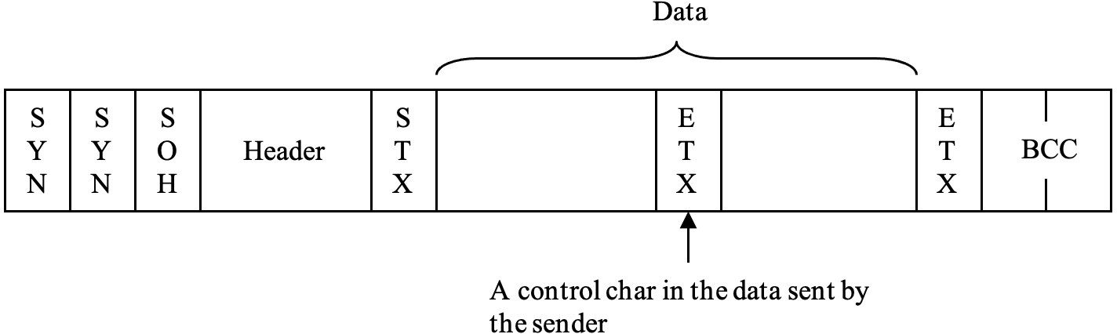
Synchronous Protocols – Byte Oriented – Data Frames
BLM3051
Data Communication and Computer Network - 5
Header includes address
Data Transparency ? (in voice and image data)
Dr. Öğr. Üyesi Furkan ÇAKMAK

Slide 29
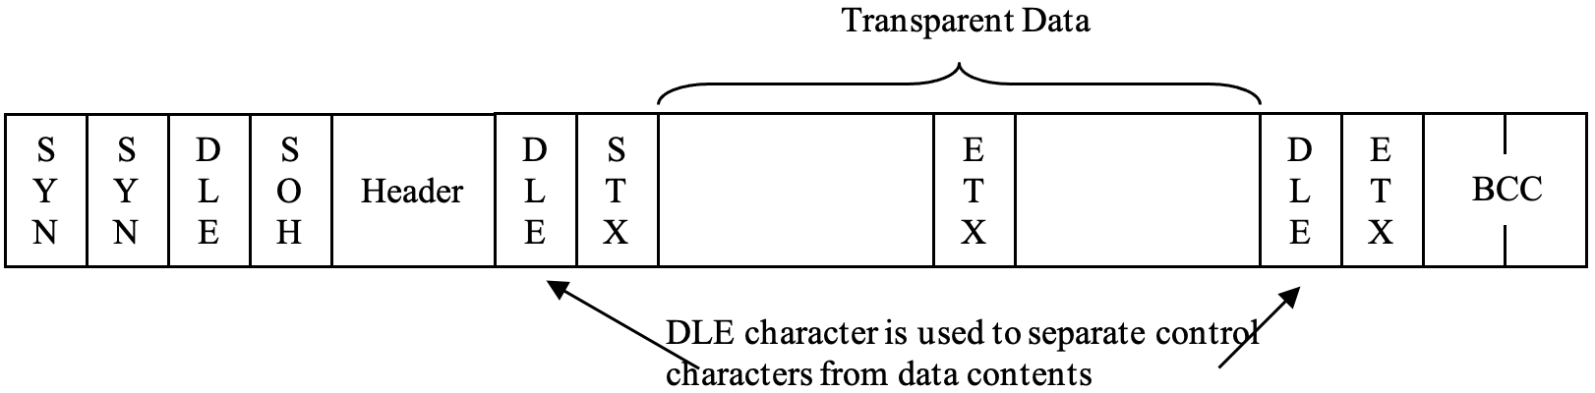
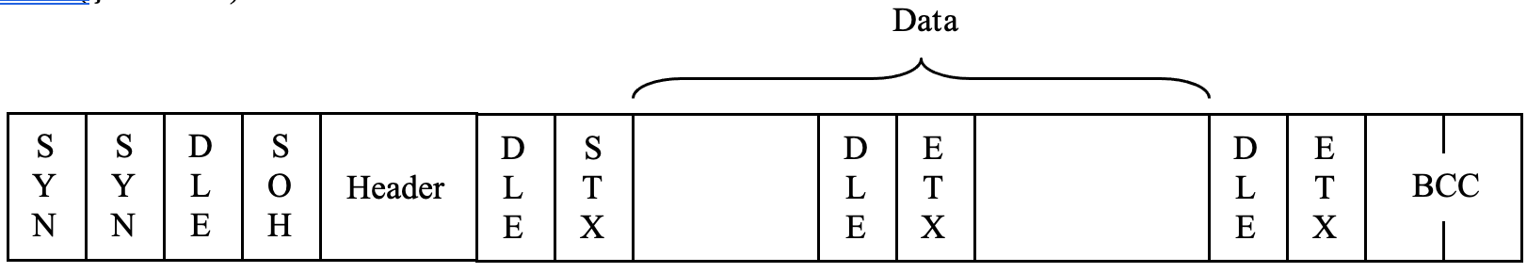
Synchronous Protocols – Byte Oriented – Data Frames
BLM3051
Data Communication and Computer Network - 5
DLE before STX, ETX, ETB, ITB, SOH control chars
If data includes DLE char?
Dr. Öğr. Üyesi Furkan ÇAKMAK

Slide 30
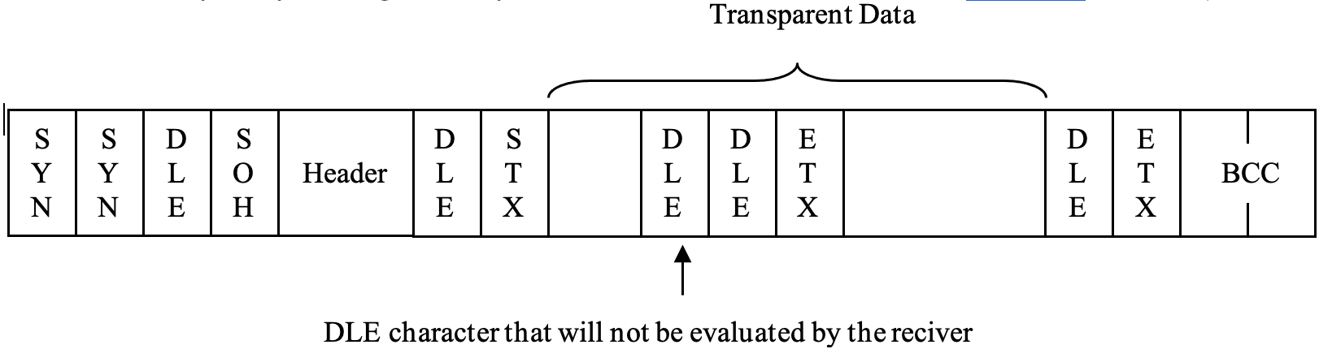
Synchronous Protocols – Byte Oriented – Data Frames
BLM3051
Data Communication and Computer Network - 5
Dr. Öğr. Üyesi Furkan ÇAKMAK

Slide 31
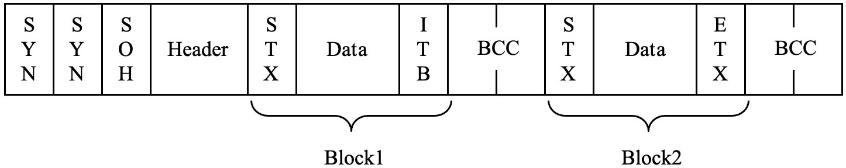
Synchronous Protocols – Byte Oriented – Multi Block Frames
BLM3051
Data Communication and Computer Network - 5
Dr. Öğr. Üyesi Furkan ÇAKMAK

Slide 32
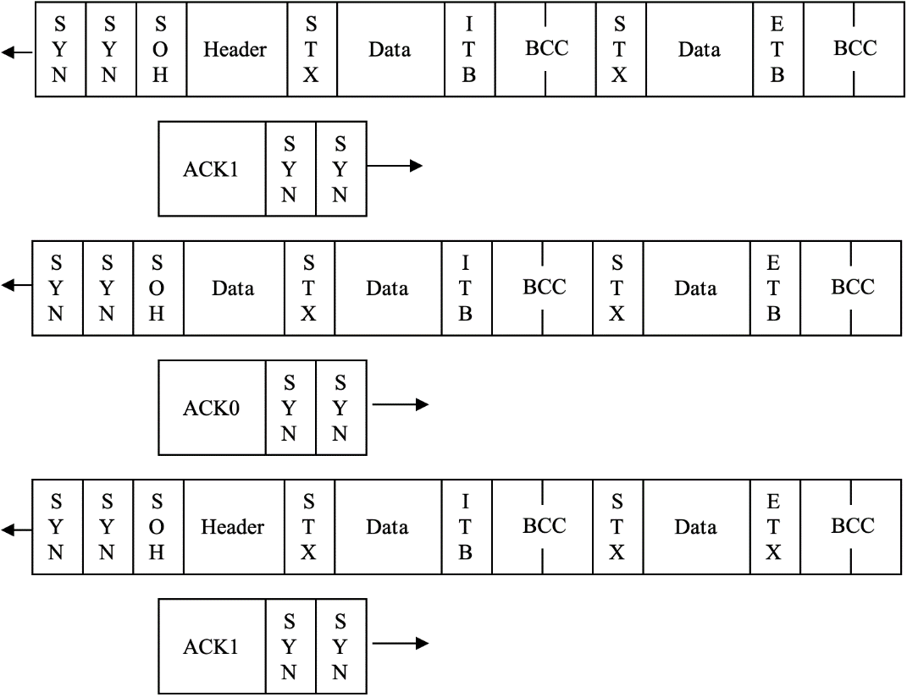
Synchronous Protocols – Byte Oriented –Multi-Frame
BLM3051
Data Communication and Computer Network - 5
Dr. Öğr. Üyesi Furkan ÇAKMAK

Slide 33
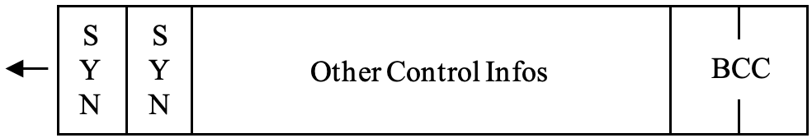
Synchronous Protocols – Byte Oriented – Control Frames
BLM3051
Data Communication and Computer Network - 5
Dr. Öğr. Üyesi Furkan ÇAKMAK

Slide 34
Synchronous Protocols – Byte Oriented – BSC (Binary Synchronous Communication)
BLM3051
Data Communication and Computer Network - 5
IBM
Used until the late 1960s
General Specs:
Suitable for point-to-point or multi-point connections
Half duplex
Use STOP & WAIT for Flow Control and ARQ
Code Dependent
Dr. Öğr. Üyesi Furkan ÇAKMAK

Slide 35
Synchronous Protocols – Bit Oriented
BLM3051
Data Communication and Computer Network - 5
Used more actively than byte oriented protocols
Fit more information into a shorter frame size
Less faced with data transparency problem
All bit oriented protocols reference HDLC (High Level Data Link Control)
ISO
General Specs:
Suitable for point-to-point or multi-point connection.
Support Half duplex and Duplex
Use Sliding Windows for Flow Control and ARQ
Code Independent
Dr. Öğr. Üyesi Furkan ÇAKMAK

Slide 36
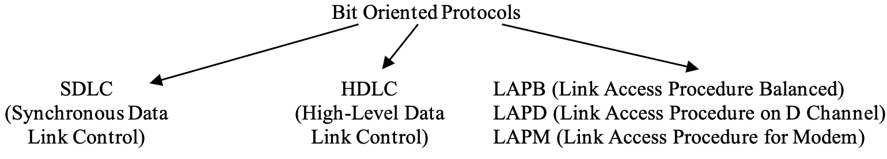
Synchronous Protocols – Bit Oriented
BLM3051
Data Communication and Computer Network - 5
Dr. Öğr. Üyesi Furkan ÇAKMAK

Slide 37
Synchronous Protocols – Bit Oriented – HDLC (High Level Data Link Control)
BLM3051
Data Communication and Computer Network - 5
Concepts used in HDLC
Station types
Primary
Secondary
Combined
Configuration
Unbalanced
Balanced (not defined in HDLC)
Modes of communication
NRM (Normal Response Mode): Unbalanced. The usual primary/secondary relationship
ARM (Asynch. Response Mode): Unbalanced. Secondary station transmit data without primary station's permission if line is available.
ABM (Asynch. Balanced Mode): Balanced
Dr. Öğr. Üyesi Furkan ÇAKMAK

Slide 38
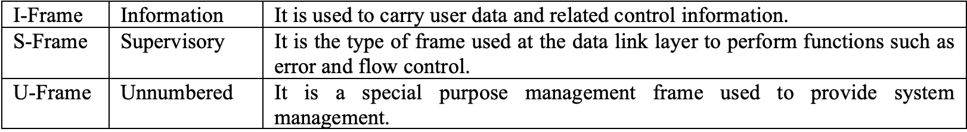
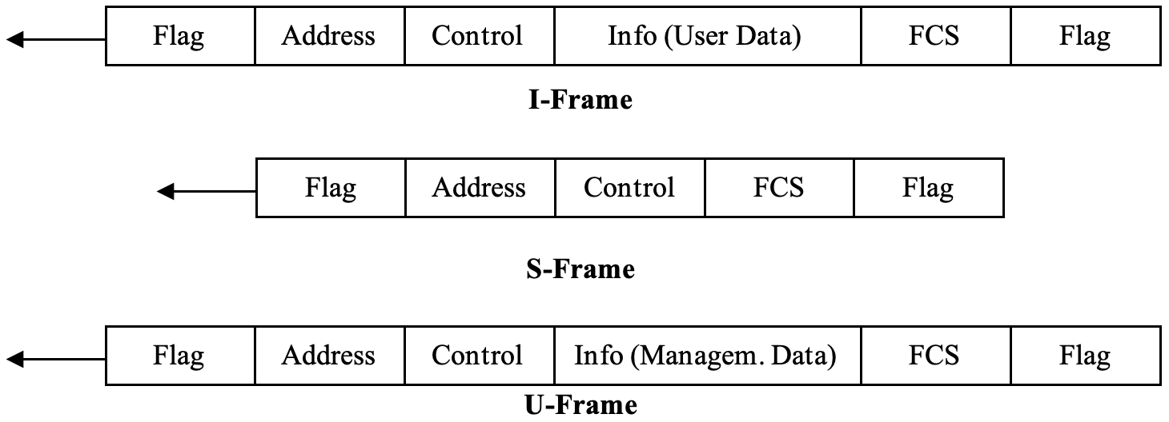
Synchronous Protocols – Bit Oriented – HDLC Frame Structure
BLM3051
Data Communication and Computer Network - 5
Dr. Öğr. Üyesi Furkan ÇAKMAK

Slide 39
Synchronous Protocols – Bit Oriented – HDLC Frame Structure – FLAG Field
BLM3051
Data Communication and Computer Network - 5
Consist of 8-bits
01111110
Determinin start and end point of frames
Ensure synchronicity
Critical point for data transparency
Bit stuffing
Sender add a 0-bit between 1’s (like escape char)
Dr. Öğr. Üyesi Furkan ÇAKMAK
Notes:
Bit stuffing: Bit doldurma

Slide 40
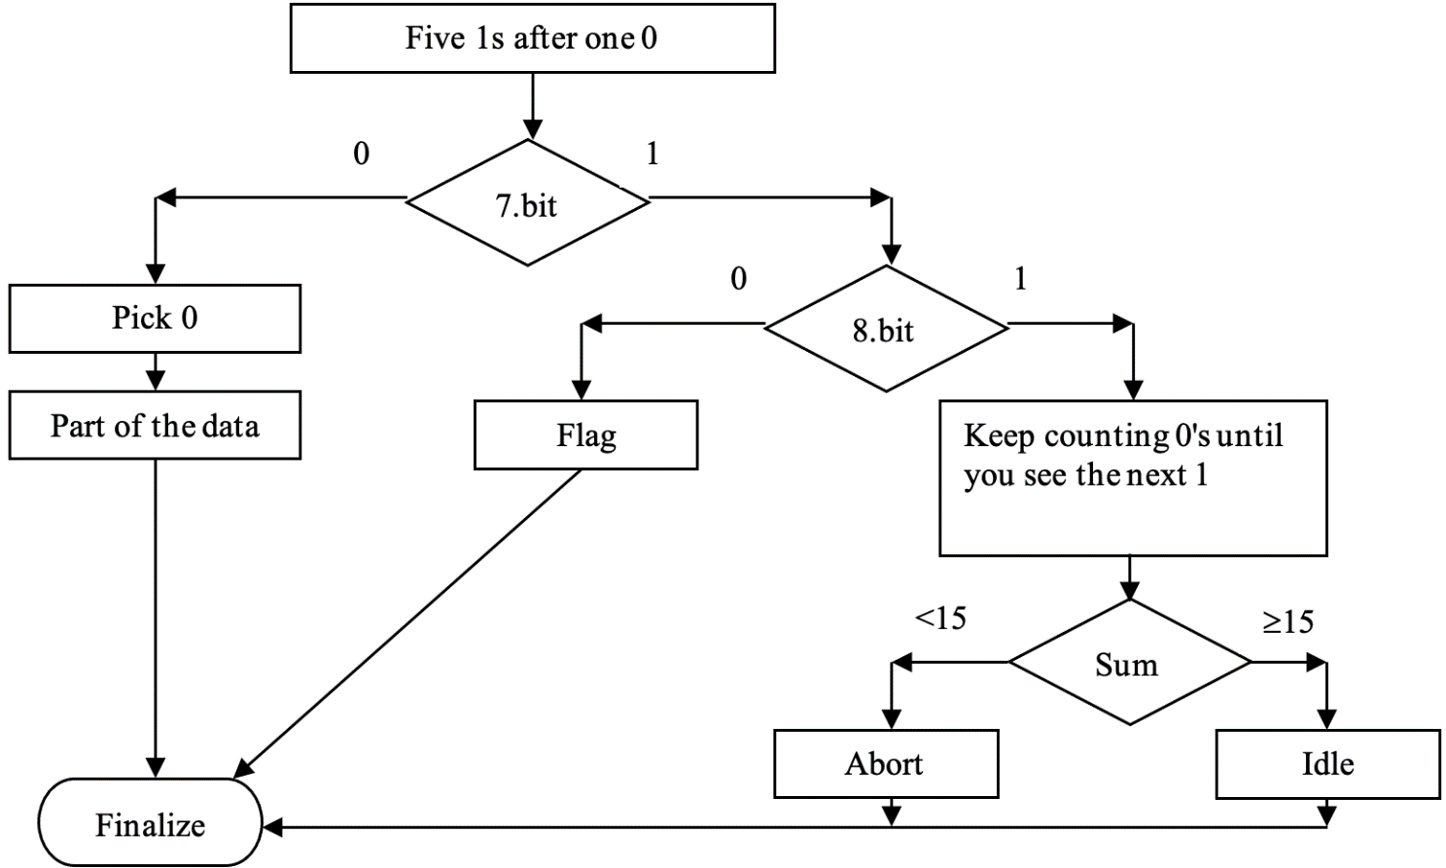
Synchronous Protocols – Bit Oriented – HDLC Frame Structure – FLAG Field - Bit Stuffing
BLM3051
Data Communication and Computer Network - 5
Dr. Öğr. Üyesi Furkan ÇAKMAK
Notes:
Bit stuffing: Bit doldurma

Slide 41
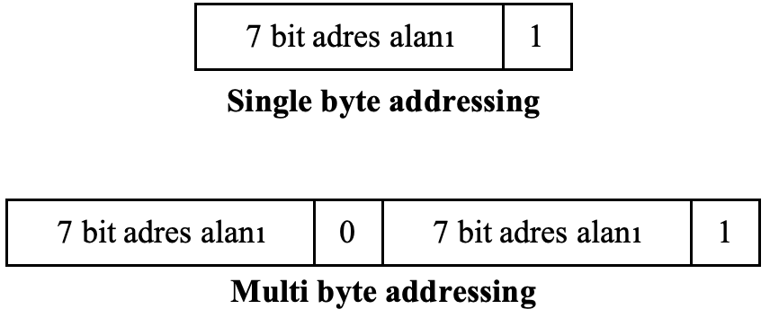
Synchronous Protocols – Bit Oriented – HDLC Frame Structure – ADDRESS Field
BLM3051
Data Communication and Computer Network - 5
Contains the address of the secondaries.
Address data is in Network Layer (Third Layer)
Used to determine whether;
Is it command? or Is it answer?
Dr. Öğr. Üyesi Furkan ÇAKMAK
Notes:
Bit stuffing: Bit doldurma

Slide 42
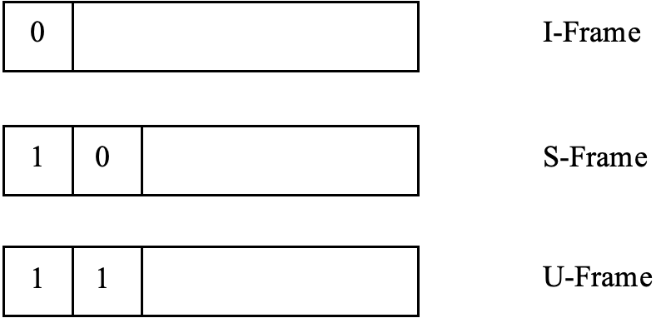
Synchronous Protocols – Bit Oriented – HDLC Frame Structure – CONTROL Field
BLM3051
Data Communication and Computer Network - 5
1 or 2 byte length
If w=7 in sliding window technique, length is 1
If w=127 in sliding window technique, length is 2
In applications with high line delays such as WAN
Dr. Öğr. Üyesi Furkan ÇAKMAK
Notes:
Bit stuffing: Bit doldurma

Slide 43
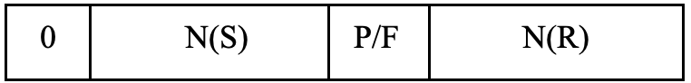
Synchronous Protocols – Bit Oriented – HDLC Frame Structure – I-Frame
BLM3051
Data Communication and Computer Network - 5
If w=7;
Each I-Frame contains 2 three-bit fields for flow an error control.
N(S): Sequence number of the sending window
Like ACK
N(R): Sequence number of the receiving window
If last frame is error-free, N(R) contains next frame's number
If last frame has errors, N(R) contains number of faulty frame
If w=127
Each I-Frame contains 2 seven-bit fields for flow an error control.
Dr. Öğr. Üyesi Furkan ÇAKMAK
Notes:
Bit stuffing: Bit doldurma

Slide 44
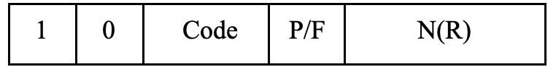
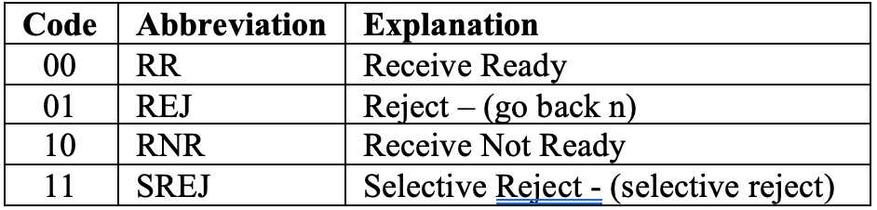
Synchronous Protocols – Bit Oriented – HDLC Frame Structure – S-Frame
BLM3051
Data Communication and Computer Network - 5
S-Frame means that neither sides has data to send to the other.
Dr. Öğr. Üyesi Furkan ÇAKMAK
Notes:
Bit stuffing: Bit doldurma

Slide 45
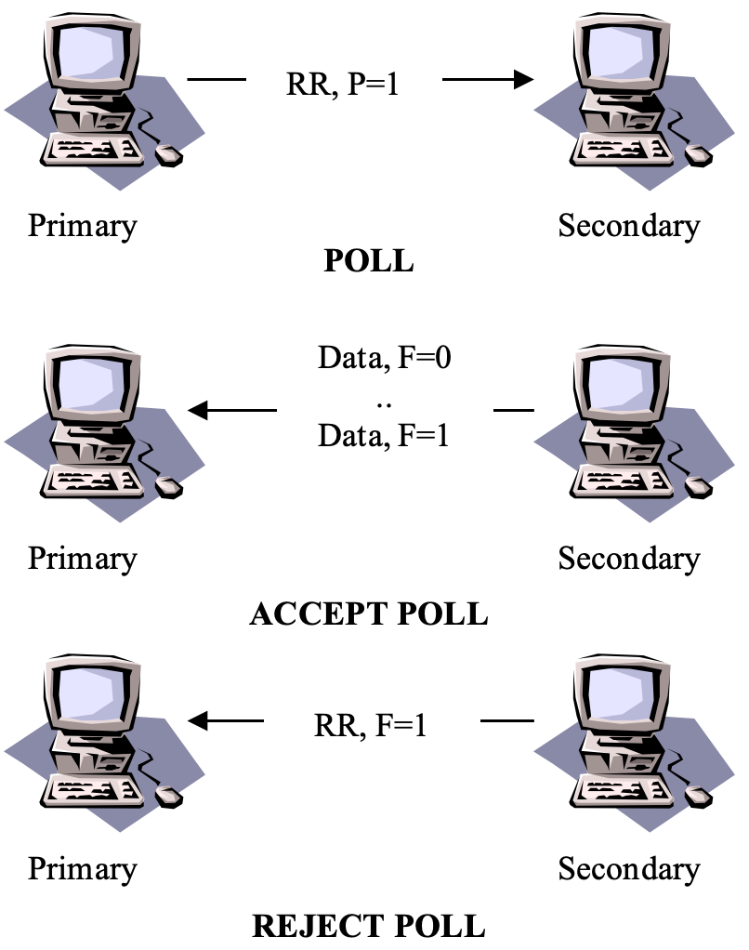
Synchronous Protocols – Bit Oriented – HDLC Frame Structure – S-Frame - RR
BLM3051
Data Communication and Computer Network - 5
It has four basic uses:
ACK
POLL
P=1
REJECT POLL
F=1
ACCEPT SELECT
F=1
Dr. Öğr. Üyesi Furkan ÇAKMAK
Notes:
Bit stuffing: Bit doldurma

Slide 46
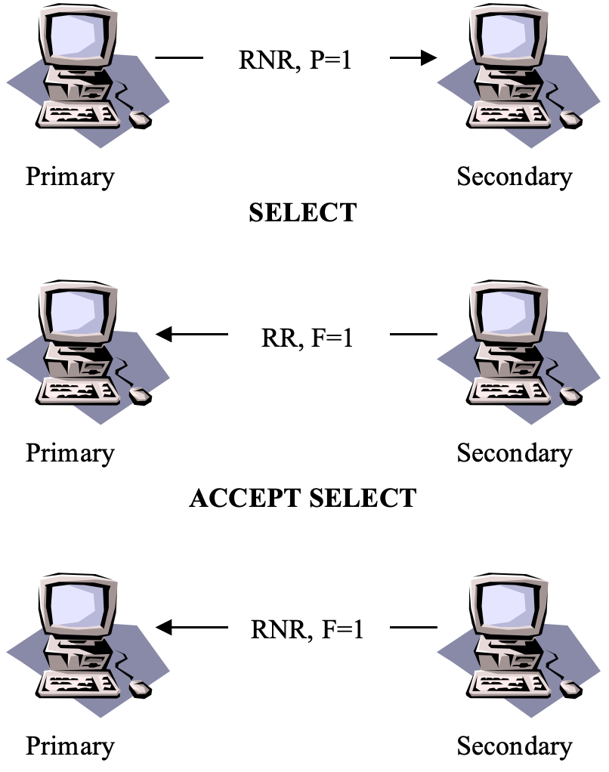
Synchronous Protocols – Bit Oriented – HDLC Frame Structure – S-Frame - RNR
BLM3051
Data Communication and Computer Network - 5
It has three basic uses:
ACK
SELECT
P=1
If primary sends RR and P=1, it means POLL.
REJECT SELECT
F=1
Dr. Öğr. Üyesi Furkan ÇAKMAK
Notes:
Bit stuffing: Bit doldurma

Slide 47
Synchronous Protocols – Bit Oriented – HDLC Frame Structure – S-Frame – REJ, SREJ
BLM3051
Data Communication and Computer Network - 5
Used to return negative feedback from the receiver
REJ: Go Back N ARQ
It is used to inform the sender that the frame whose number is written in the N (R) field and the frames that come after it did not reach the receiver or that it received incorrectly, and to ensure that it is sent again.
SREJ: Selective Reject ARQ
It is used in the N (R) field to inform the sender that the data frame whose number is written on it did not reach the receiver or that it was received incorrectly and to send it again.
Dr. Öğr. Üyesi Furkan ÇAKMAK
Notes:
Bit stuffing: Bit doldurma

Slide 48
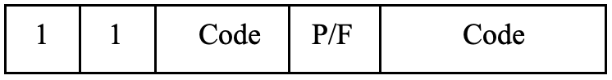
Synchronous Protocols – Bit Oriented – HDLC Frame Structure – U-Frame
BLM3051
Data Communication and Computer Network - 5
Used to provide session control
The data area is used to carry information required for system management functions
1st code field consist of 2 bits
2nd code field consist of 3 bits
2⁵ = 32 different state
These states (commands and answers) can be collected in 5 different categories:
Mode setting
Unnumbered exchange
Disconnection
Initialization
Miscellaneous
Dr. Öğr. Üyesi Furkan ÇAKMAK
Notes:
Bit stuffing: Bit doldurma

Slide 49
Synchronous Protocols – Bit Oriented – HDLC Frame Structure – U-Frame – Mode Setting
BLM3051
Data Communication and Computer Network - 5
How will the transmission be?
00-001 (SNRM-Set Normal Response Mode) -> w=7
11-000 (SARM-Set Async. Response Mode) -> w=7
11-100 (SABM-Set Async. Balanced Mode) -> w=7
11-011 (SNRM Extended) -> w=127
11-010 (SARM Extended) -> w=127
11-110 (SABM Extended) -> w=127
Dr. Öğr. Üyesi Furkan ÇAKMAK
Notes:
Bit stuffing: Bit doldurma

Slide 50
Synchronous Protocols – Bit Oriented – HDLC Frame Structure – U-Frame – Unnumbered Exchange
BLM3051
Data Communication and Computer Network - 5
Data connection information exchange
00-100 (UP-Unnumbered Poll): POLL request
00-000 (UI-Unnumbered Info): exchange of date/time information to be used for sync.
UI would be a command or answer.
If it is used for command, it transports list of parameters to be used for transmission.
If it is used for answer, it carries information that determines the capability of the receiver.
00-110 (UA-Unnumbered Ack): Sent in response to the UP command
Dr. Öğr. Üyesi Furkan ÇAKMAK
Notes:
Bit stuffing: Bit doldurma

Slide 51
Synchronous Protocols – Bit Oriented – HDLC Frame Structure – U-Frame – Disconnection
BLM3051
Data Communication and Computer Network - 5
There are 3 types of disconnection command.
00-010 (DISC): Sent by the first side to terminate the connection to the other.
00-010 (RD): It is used to notify the request to terminate the connection from the second station to the first.
11-000 (DM): When the address is sent from the specified station to the station wishing to establish the connection, it is sent as negative feedback information to the mode setting command.
Dr. Öğr. Üyesi Furkan ÇAKMAK
Notes:
Bit stuffing: Bit doldurma

Slide 52
Synchronous Protocols – Bit Oriented – HDLC Frame Structure – U-Frame – Initialization
BLM3051
Data Communication and Computer Network - 5
Used for initializations for all sides.
10-000 with P (SIM-Set Initialization Mode)
Command is sent from the first station to the second
UI command will be sent in response to SIM command
10-000 with F (RIM-Request Initialization Mode)
It means that «I am waiting SIM commad»
It is used when the second station cannot respond to the mode setting command without receiving the SIM command from the first.
Dr. Öğr. Üyesi Furkan ÇAKMAK
Notes:
Bit stuffing: Bit doldurma

Slide 53
Synchronous Protocols – Bit Oriented – HDLC Frame Structure – U-Frame – Miscellaneous
BLM3051
Data Communication and Computer Network - 5
11-001 (RESET)
This is usually sent in response to a received FRMR code.
Explains that the secondary station must do the same
11-101 (XID)
Emphasizes that a self-determining information is requested from the secondary station.
Like questioning what your address is
10-001 (FRMR)
Used to determine that a syntax error was encountered in the received frame.
Dr. Öğr. Üyesi Furkan ÇAKMAK
Notes:
Bit stuffing: Bit doldurma

Slide 54

Synchronous Protocols – Bit Oriented – HDLC Frame Structure – S-Frame – P/F (Poll/ Final)
BLM3051
Data Communication and Computer Network - 5
P/F bit is always 1
Dr. Öğr. Üyesi Furkan ÇAKMAK
Notes:
Bit stuffing: Bit doldurma

Slide 55
Synchronous Protocols – Bit Oriented – HDLC Mechanism
BLM3051
Data Communication and Computer Network - 5
I, U and S frames
3-phase mechanism
One of the sides must install the link
in order to be able to exchange data sequentially
User data, flow and control information required for error control must be transferred between the two ends.
One of the sides terminates the connection
Dr. Öğr. Üyesi Furkan ÇAKMAK
Notes:
Bit stuffing: Bit doldurma

Slide 56
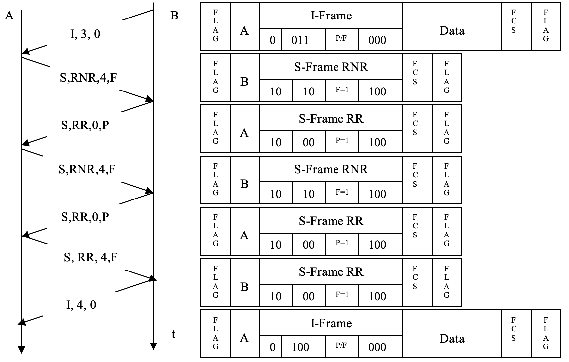
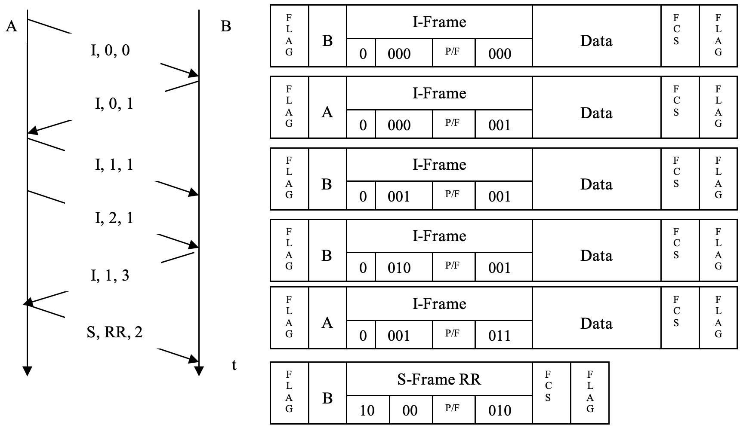
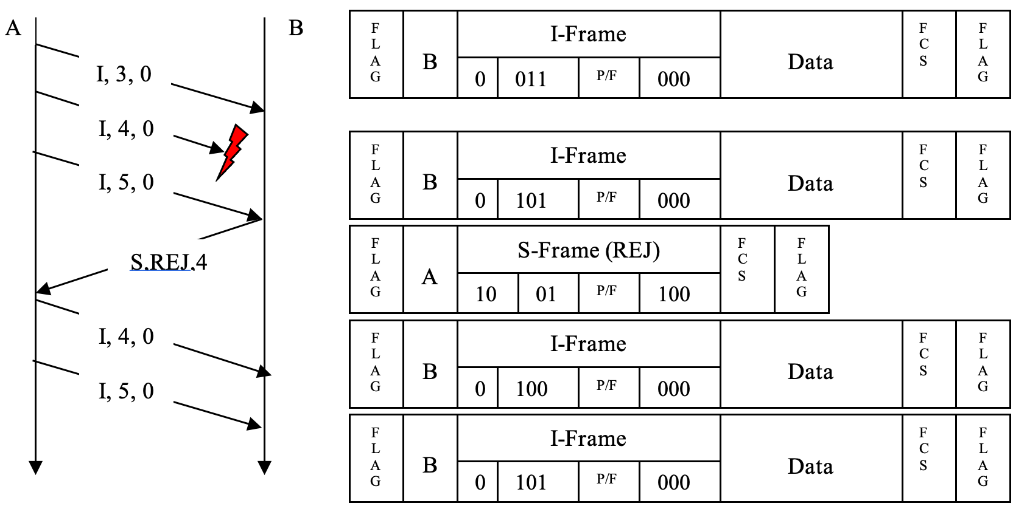
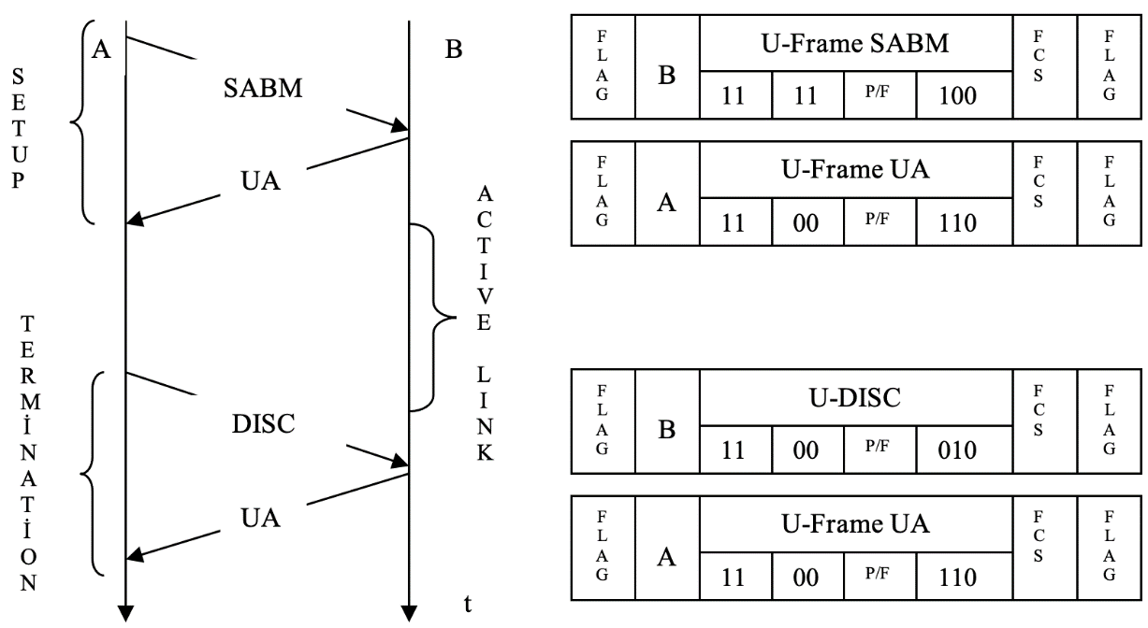
Synchronous Protocols – Bit Oriented – HDLC Mechanism – Con’t
BLM3051
Data Communication and Computer Network - 5
Dr. Öğr. Üyesi Furkan ÇAKMAK

Slide 57
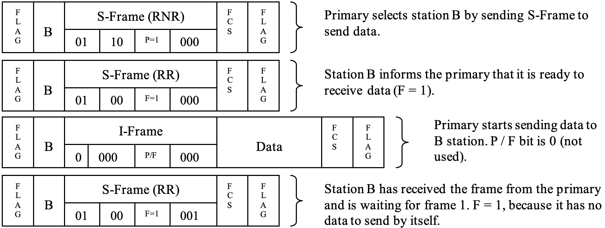
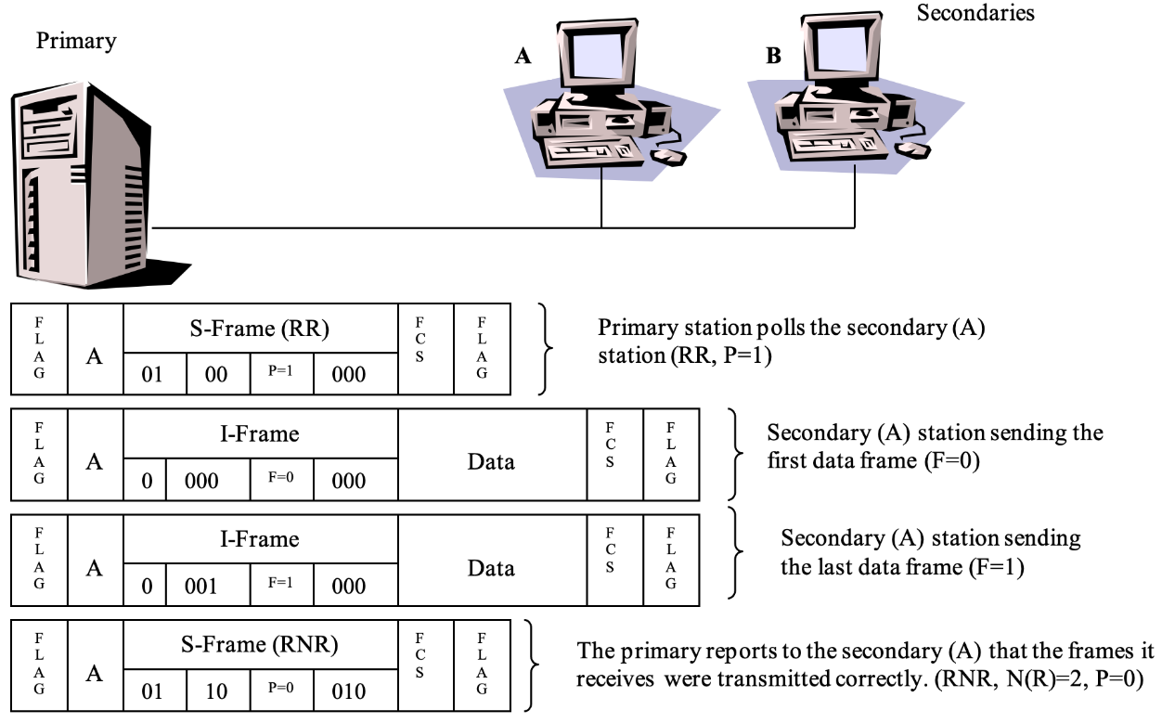
Synchronous Protocols – Bit Oriented – HDLC Mechanism – Multi-Point
BLM3051
Data Communication and Computer Network - 5
Dr. Öğr. Üyesi Furkan ÇAKMAK

Slide 58

Synchronous Protocols – Bit Oriented – HDLC Mechanism – Combined
BLM3051
Data Communication and Computer Network - 5
Dr. Öğr. Üyesi Furkan ÇAKMAK

Slide 59

Thank you for your listening.
BLM3051
Data Communication and Computer Network - 5
Dr. Öğr. Üyesi Furkan ÇAKMAK

